Slide 1
2.1
Right-triangle definitions of trig functions (SOHCAHTOA), cofunctions, special angle values

Slide 2
Bell Work
Right-triangle definitions of trig functions
Bell Work
1) Evaluate $\cos^{2}\left(180°\right)−2cot⁡(−270°)$
2) Find the six trig functions if tan$θ=\frac{3}{4}$
sinΘ cosΘ
secΘ cscΘ
tanΘ cotΘ
3) Where do cows have their sweat glands in their bodies?
Θ
Notes:
Ask who used SOHCAHTOA on #2- explain, SOHCAHTOA lets us find the ratios from any acute angle- not just the one between the radius and x axis.
Trivia: nose

Slide 3
Check Cornell Notes

Slide 4
What is the difference between cofunctions and reciprocal functions?
Cofunction Identities

Slide 5

Write the function in terms of its cofunction
$cos 52°$
B) $tan71°$

Slide 6

Find one solution (assume angles are acute)
$$cos\left(θ+4°\right)=sin\left(3θ+2°\right)$$

Slide 7
Cofunction Identities

Slide 8
Compare function values of Acute Angles: True/ False
$sin21°>sin18°$
b) $cos49°≤cos56$
Notes:
Use geogebra sketch if necessary

Slide 9
What do you remember about special Triangles?

Slide 10
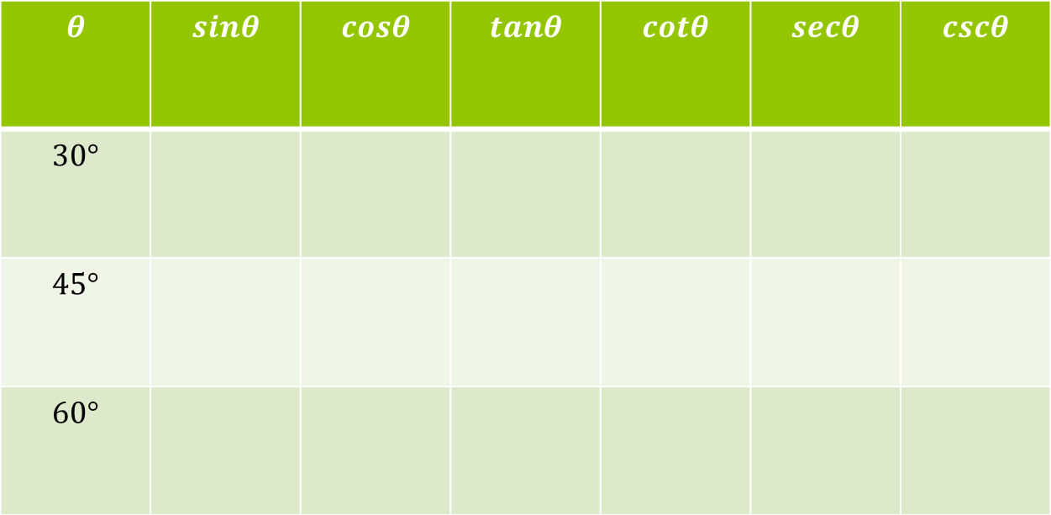
Use your knowledge of Special triangles to find the following trig ratios
$$θ$$ | $$sinθ$$ | $$cosθ$$ | $$tanθ$$ | $$cotθ$$ | $$secθ$$ | $$cscθ$$
$$30°$$
$$45°$$
$$60°$$

Slide 11
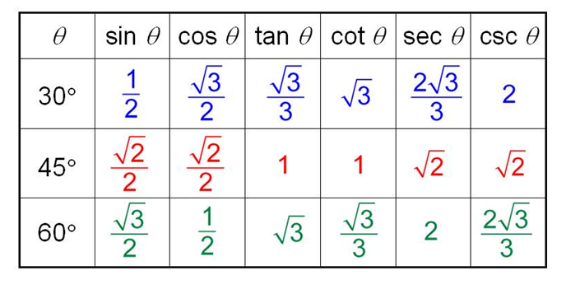
Check your answers

Slide 12
Practice- Get a partner and two dice
First Roll: Function
Sin
Sec
Tan
Cos
Csc
Cot
Second Roll: Angle
30°
45°
60°
0°
90°
180°

Slide 13
Exit Slip
Write sec(50°) in terms of it’s cofunction.
Find one solution: $tan(2θ−18°)=cot(0+18)$
What is your plan for memorizing the function values for special angles?

