Slide 1
Viernes, el 5 de octubre

Slide 2
Frase del día

Slide 3
Check Homework
Flashcards
Return listening activity
Collect Hw

Slide 4
Pronoun Paradise Video

Slide 5
Practice Using Your Flashcards
With a partner and BOTH your sets of cards,
Put one set English side up and one set
Spanish side up. Scramble them and then match them on your desk like the example on the board.

Slide 6
Around the World with Subject Pronouns

Slide 7
you (formal)

Slide 8
They,
all girls

Slide 9
You all
(Mixed group)
(españa)

Slide 10
you (familiar)

Slide 11
Jorge

Slide 12
I

Slide 13
You all

Slide 14
Lydia

Slide 15
Sandra, Jose,
y yo

Slide 16
You (to your mom)

Slide 17
You all
(not in spain)

Slide 18
Paco y tú

Slide 19
Mi profesora

Slide 20
You all
(Mixed group)
(españa)

Slide 21
They (all girls)

Slide 22
Isabel y Sandra

Slide 23
He

Slide 24
Paco, Sara y tú (españa)

Slide 25
Rico

Slide 26
Sandra, Jose,
y yo

Slide 27
She

Slide 28
Sara

Slide 29
Jorge y Sara

Slide 30
You all
(all girls)
españa

Slide 31
I

Slide 32
Sandra, Jose,
y yo

Slide 33
We (all boys)

Slide 34
Maria

Slide 35
Jorge y Sara

Slide 36
You all
(all girls)
españa

Slide 37
You (formal)

Slide 38
Sandra, Jose,
y yo

Slide 39
She

Slide 40
Sara

Slide 41
Jorge y Sara

Slide 42
You all
(all girls)
españa

Slide 43
I

Slide 44
Sandra, Jose,
y yo

Slide 45
We (all boys)

Slide 46
Maria

Slide 47
Jorge y Sara

Slide 48
You all
(all girls)
españa

Slide 49
We
(all girls)

Slide 50
THE END!

Slide 52
Looking at Verbs: “to win”
I win We win
You win You all win
He win They win
She win

Slide 53
Looking at Verbs: “to be”
I am We are
You are You all are
He is They are
She is

Slide 55
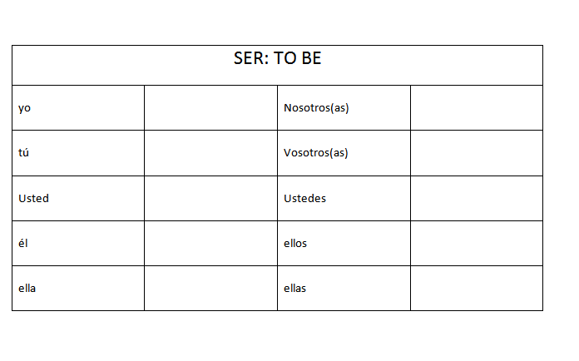

Slide 56
SER VIDEO

Slide 57
