Slide 1
Días de la semana
DAYS OF THE WEEK

Slide 2
¿ Qué día es hoy?
What day is it today?
Today is…
Hoy es…

Slide 3
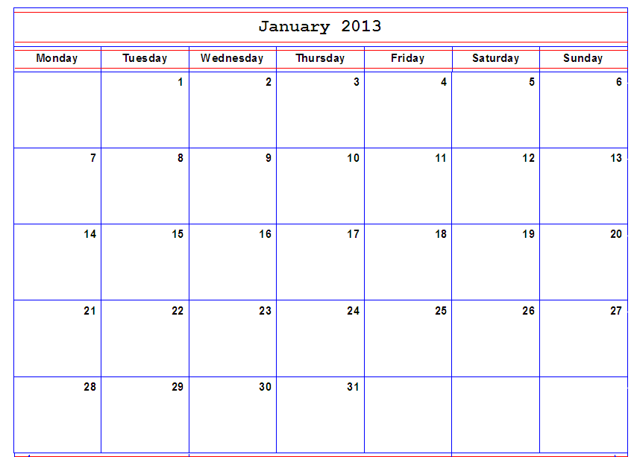
Spanish calendar starts on Monday!

Slide 4
Today is
Martin Luther King
Day
(January 21st)
Hoy es lunes.

Slide 5
Today is New Years.
Hoy es martes.

Slide 6
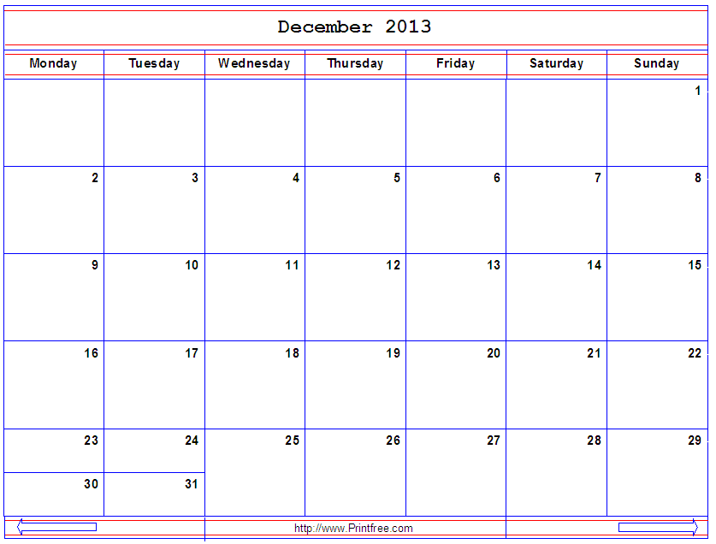
It’s Christmas!
December 25th
Hoy es miércoles.

Slide 7
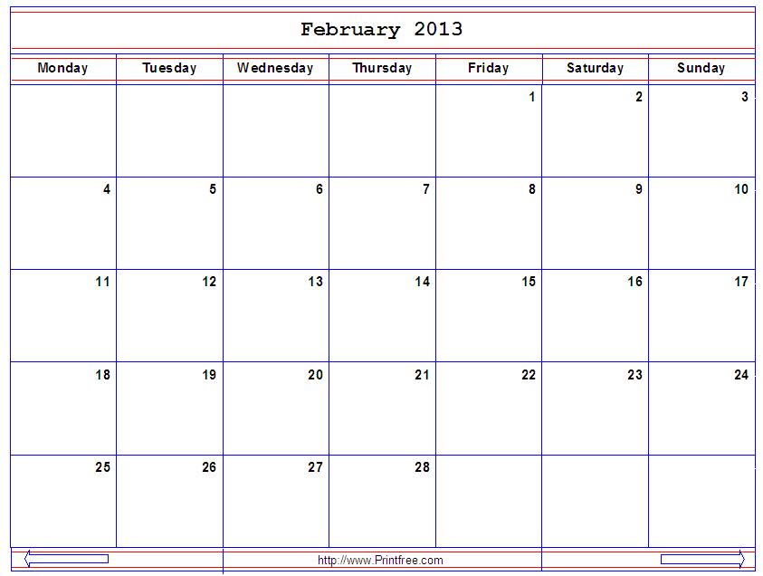
Today is Valentine’s Day.
Hoy es jueves.

Slide 8
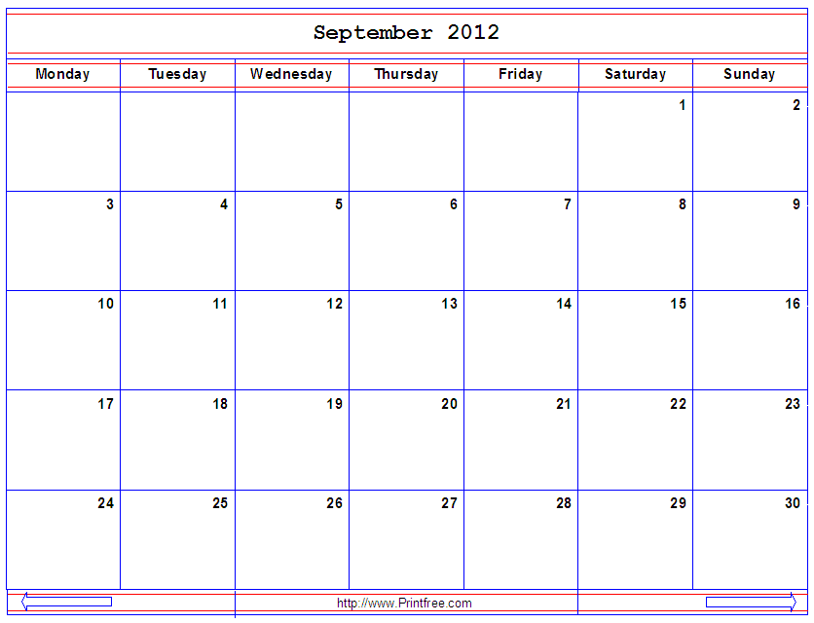
¿ Qué día es hoy?
Hoy es viernes.

Slide 9
Manaña es… sábado.

Slide 10
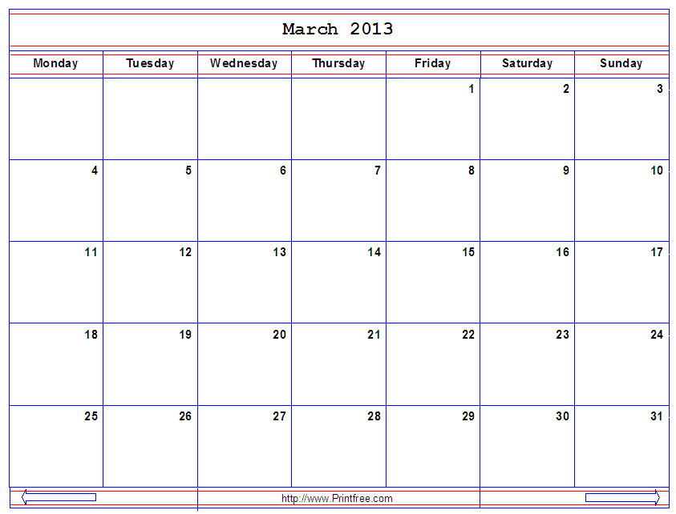
It’s my Birthday (March 10th)
Hoy es domingo.

Slide 11
Days of the week are not capitalized!
lunes | martes | miércoles | jueves | viernes | sábado | domingo
Monday | Tuesday | Wednesday | Thursday | Friday | Saturday | Sunday
¿ Qué día es hoy?
Hoy es…
Mañana

Slide 12
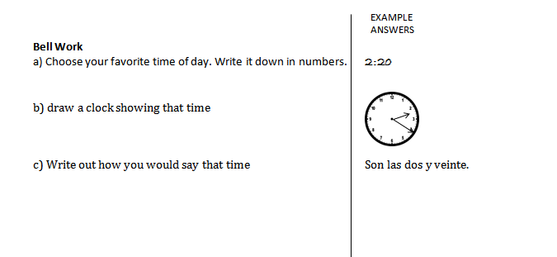
Bell Work

Slide 13
Qué hora es... Qué día es hoy? Hoy es... Mañana Qué es tú numero de teléfono? Mi numero es... Cómo se escribe…

Slide 14
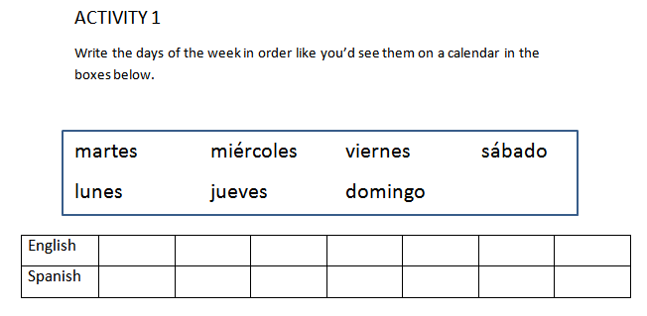

Slide 15
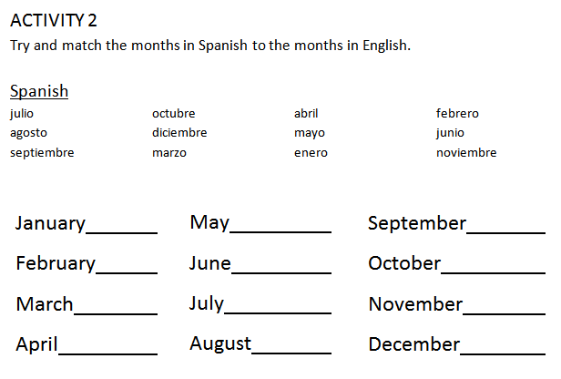

Slide 16
Tres de octubre de 2012
Frase del Día- Phrase of the day!
“No pasa nada” =
Context:
Say a kid steps on your foot and says
“lo siento”
It didn’t bother or hurt you, so you reply…
“no pasa nada”

Slide 17
Writing the Date
¿Qué fecha es hoy? What’s today’s date?
¿Qué día es hoy? What day is today?

Slide 18
¿Qué fecha es hoy?
Example:
Hoy es el 2 de octubre.
Today is the 2nd of October.
Example: What if we want to say
Today is February 20th?

Slide 19
¿Qué fecha es hoy?
Example:
Hoy es el 2 de octubre.
Today is the 2nd of October.
Example: What if we want to say
Today is February 20th?
Hoy es el 20 de febrero.
What do you notice about the order they write it in?

Slide 20
Writing the date in Spanish (Short Hand)
What day is 2-5-2012?

Slide 21
Date Format:
Day/ Month / Year
5/ 7/ 2012 =
19 / 6 / 1989 =
answer

Slide 22
Date Format:
Day/ Month / Year
5/ 7/ 2012 = el cinco de julio 2012
19 / 6 / 1989 = el diecinueve de junio 1989

Slide 23
Birthdays!
¿Cuándo es tu cumpleaños?
When is your birthday?
Mi cumpleaños es….
My birthday is….

Slide 24
Subject Pronouns
Jorge is my friend. Jorge is from Venezuela. Jorge and I like to play soccer together- but just as friends because Jorge is dating Julie. Jorge and Julie are a cute couple. Jorge and Julie like to go to the movies. Julie and I aren’t really friends. Julie likes ballet and other girly things. Julie also lives in Dallas. Julie and I could be friends if we liked the same things and lived closer.

Slide 25
List out all the subject Pronouns

Slide 26
Spanish Subject Pronouns
Single Person |  | Multiple People
I | Yo | We | Nosotros
 |  | We (all female) | Nosotras
You (familiar) | tú
You (formal) | usted | You all | ustedes
He | él | They (males) | ellos
She | ella | They (females) | ellas

Slide 27
Spanish Subject Pronouns
Single Person |  | Multiple People
I | Yo | We | Nosotros
 |  | We (all female) | Nosotras
You (familiar) | tú | You all (in Spain) | vosotros or vosotras (all f)
You (formal) | usted | You all | ustedes
He | él | They (males) | ellos
She | ella | They (females) | ellas

Slide 28
Activity 16 page 14

